Slide 1
Recurrent Neural Network (RNN)

Slide 2

Example Application
Slot Filling
I would like to arrive Taipei on November 2nd.
ticket booking system
Destination:
Taipei
Slot
time of arrival:
November 2nd
Notes:
https://catalog.ldc.upenn.edu/docs/LDC93S4B/corpus.html

Slide 3
Example Application
Solving slot filling by Feedforward network?
Input: a word
(Each word is represented as a vector)
Taipei

Slide 4
1-of-N encoding
How to represent each word as a vector?
1-of-N Encoding
lexicon = {apple, bag, cat, dog, elephant}
The vector is lexicon size.
apple = [ 1 0 0 0 0]
bag = [ 0 1 0 0 0]
Each dimension corresponds to a word in the lexicon
cat = [ 0 0 1 0 0]
The dimension for the word is 1, and others are 0
dog = [ 0 0 0 1 0]
elephant = [ 0 0 0 0 1]
Notes:
Can be very large

Slide 5
Beyond 1-of-N encoding
Dimension for “Other”
Word hashing
apple
0
a-a-a
0
bag
0
a-a-b
0
…
…
cat
0
a-p-p
1
dog
0
…
…
…
26 X 26 X 26
elephant
0
p-l-e
1
…
…
p-p-l
1
“other”
1
…
…
w = “apple”
w = “Gandalf”
w = “Sauron”

Slide 6
Example Application
time of departure
dest
Solving slot filling by Feedforward network?
Input: a word
(Each word is represented as a vector)
Output:
Probability distribution that the input word belonging to the slots
Taipei

Slide 7
Example Application
time of departure
dest
arrive Taipei on November 2nd
other
dest
other
time
time
Problem?
leave Taipei on November 2nd
place of departure
Neural network needs memory!
Taipei

Slide 8
Recurrent Neural Network (RNN)
The output of hidden layer are stored in the memory.
store
Memory can be considered as another input.

Slide 9
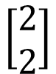
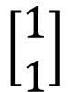
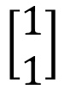
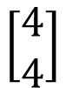
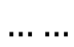
Example
Input sequence:
$$\left[\begin{aligned}1 \\ 1\end{aligned}\right]$$
$$\left[\begin{aligned}1 \\ 1\end{aligned}\right]$$
$$\left[\begin{aligned}2 \\ 2\end{aligned}\right]$$
$$……$$
output sequence:
$$\left[\begin{aligned}4 \\ 4\end{aligned}\right]$$
4
4
store
2
2
given Initial values
0
0
All the weights are “1”, no bias
1
1
All activation functions are linear

Slide 10
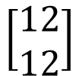
Example
Input sequence:
$$\left[\begin{aligned}1 \\ 1\end{aligned}\right]$$
$$\left[\begin{aligned}1 \\ 1\end{aligned}\right]$$
$$\left[\begin{aligned}2 \\ 2\end{aligned}\right]$$
$$……$$
output sequence:
$$\left[\begin{aligned}4 \\ 4\end{aligned}\right]$$
$$\left[\begin{aligned}12 \\ 12\end{aligned}\right]$$
12
12
store
6
6
2
2
All the weights are “1”, no bias
1
1
All activation functions are linear

Slide 11
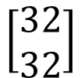
Example
Input sequence:
$$\left[\begin{aligned}1 \\ 1\end{aligned}\right]$$
$$\left[\begin{aligned}1 \\ 1\end{aligned}\right]$$
$$\left[\begin{aligned}2 \\ 2\end{aligned}\right]$$
$$……$$
output sequence:
$$\left[\begin{aligned}4 \\ 4\end{aligned}\right]$$
$$\left[\begin{aligned}12 \\ 12\end{aligned}\right]$$
$$\left[\begin{aligned}32 \\ 32\end{aligned}\right]$$
Changing the sequence order will change the output.
32
32
store
16
16
6
6
All the weights are “1”, no bias
2
2
All activation functions are linear

Slide 12
RNN
The same network is used again and again.
Probability of “arrive” in each slot
Probability of “Taipei” in each slot
Probability of “on” in each slot
y¹
y²
y³
store
store
a¹
a²
a³
a¹
a²
x¹
x²
x³
arrive Taipei on November 2nd
Notes:
General idea

Slide 13
RNN
Different
Prob of “leave” in each slot
Prob of “Taipei” in each slot
Prob of “arrive” in each slot
Prob of “Taipei” in each slot
y²
……
y²
……
y¹
y¹
store
store
a¹
a²
a¹
a²
a¹
……
a¹
……
x¹
x²
……
x¹
x²
……
leave
Taipei
arrive
Taipei
The values stored in the memory is different.
Notes:
Output y^{i} depends on x¹, x², …… x^{i}
The same input can have totoally different output.

Slide 14
Of course it can be deep …
y^{t}
y^{t+1}
y^{t+2}
……
……
……
……
……
……
……
……
……
x^{t}
x^{t+1}
x^{t+2}

Slide 15
Elman Network & Jordan Network
Elman Network
Jordan Network
y^{t}
y^{t+1}
y^{t}
y^{t+1}
W^{h}
Wº
Wº
Wº
Wº
……
……
……
……
W^{h}
W^{i}
W^{i}
W^{i}
W^{i}
x^{t}
x^{t+1}
x^{t}
x^{t+1}

Slide 16
Bidirectional RNN
……
x^{t}
x^{t+1}
x^{t+2}
……
y^{t}
y^{t+1}
y^{t+2}
……
……
x^{t}
x^{t+1}
x^{t+2}
Notes:
To determine yi, you have to consider a lot ……
You should see the whole sequence

Slide 17
Long Short-term Memory (LSTM)
Other part of the network
Special Neuron:
4 inputs,
1 output
Signal control the output gate
Output Gate
(Other part of the network)
Memory
Cell
Forget Gate
Signal control the forget gate
(Other part of the network)
Signal control the input gate
Input Gate
LSTM
(Other part of the network)
Other part of the network
Notes:
Normal neuron
1 input, 1 output
This one
4 input, 1 output

Slide 18
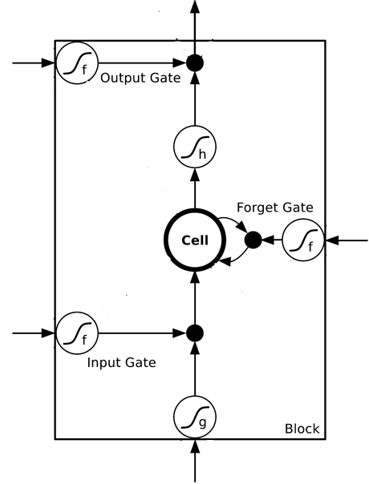
$$a$$
$$=h\left(c^{′}\right)f\left(z_{o}\right)$$
$$z_{o}$$
multiply
Activation function f is usually a sigmoid function
$$f\left(z_{o}\right)$$
$$h\left(c^{′}\right)$$
Between 0 and 1
Mimic open and close gate
$$c$$
$$f\left(z_{f}\right)$$
c
$$c^{′}$$
$$z_{f}$$
$$cf\left(z_{f}\right)$$
$$c^{′}=g\left(z\right)f\left(z_{i}\right)+cf\left(z_{f}\right)$$
$$f\left(z_{i}\right)$$
$$g\left(z\right)f\left(z_{i}\right)$$
$$z_{i}$$
multiply
$$g\left(z\right)$$
$$z$$

Slide 19
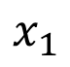
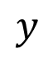
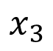
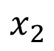
LSTM - Example
0
0
3
3
7
7
7
0
6
$$x_{1}$$
1
0
0
3
1
0
2
0
0
4
1
0
2
0
0
1
0
1
3
-1
0
6
1
0
1
0
1
$$x_{2}$$
$$x_{3}$$
$$y$$
0
0
0
0
0
7
0
0
6
When x₂ = 1, add the numbers of x₁ into the memory
When x₂ = -1, reset the memory
When x₃ = 1, output the number in the memory.
Notes:
Can you find the rule?

Slide 20
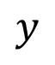
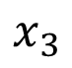
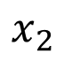
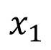
x₁
0
y
$$y$$
0
0
0
7
0
x₂
0
+
x₃
100
0
x₁
1
-10
100
0
0
+
x₂
x₁
0
x₃
x₂
100
+
10
1
x₃
0
1
-10
+
$$x_{1}$$
3
1
0
4
1
0
2
0
0
1
0
1
3
-1
0
1
0
0
0
$$x_{2}$$
x₁
x₂
x₃
1
$$x_{3}$$
Notes:
Look at the sequence first

Slide 21
3
0
≈0
y
$$y$$
0
0
0
7
0
1
0
+
≈0
3
0
100
0
3
1
-10
0
100
0
3
+
1
3
≈1
0
0
100
≈1
3
1
+
10
1
3
0
0
1
-10
+
$$x_{1}$$
3
1
0
4
1
0
2
0
0
1
0
1
3
-1
0
1
0
0
0
$$x_{2}$$
3
1
0
1
$$x_{3}$$

Slide 22
4
0
≈0
y
$$y$$
0
0
0
7
0
1
0
+
≈0
7
0
100
0
4
1
-10
7
100
0
3
+
1
4
≈1
0
0
100
≈1
4
1
+
10
1
4
0
0
1
-10
+
$$x_{1}$$
3
1
0
4
1
0
2
0
0
1
0
1
3
-1
0
1
0
0
0
$$x_{2}$$
4
1
0
1
$$x_{3}$$

Slide 23
2
0
≈0
y
$$y$$
0
0
0
7
0
0
0
+
≈0
7
0
100
0
2
1
-10
7
100
0
+
0
2
≈1
0
0
100
≈0
0
0
+
10
1
2
0
0
1
-10
+
$$x_{1}$$
3
1
0
4
1
0
2
0
0
1
0
1
3
-1
0
1
0
0
0
$$x_{2}$$
2
0
0
1
$$x_{3}$$

Slide 24
1
0
≈7
y
$$y$$
0
0
0
7
0
0
0
+
≈1
7
1
100
0
1
1
-10
7
100
0
+
0
1
≈1
0
1
100
≈0
0
0
+
10
1
1
1
0
1
-10
+
$$x_{1}$$
3
1
0
4
1
0
2
0
0
1
0
1
3
-1
0
1
0
0
0
$$x_{2}$$
1
0
1
1
$$x_{3}$$

Slide 25
3
0
≈0
y
$$y$$
0
0
0
7
0
-1
0
+
≈0
0
0
100
0
3
1
-10
0
100
0
7
+
-1
3
≈0
0
0
100
≈0
0
-1
+
10
1
3
0
0
1
-10
+
$$x_{1}$$
3
1
0
4
1
0
2
0
0
1
0
1
3
-1
0
1
0
0
0
$$x_{2}$$
3
-1
0
1
$$x_{3}$$

Slide 26
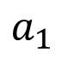
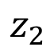
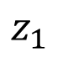
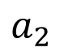
Original Network:
Simply replace the neurons with LSTM
……
……
$$a_{1}$$
$$a_{2}$$
$$z_{1}$$
$$z_{2}$$
x₁
x₂
Input
Notes:
Use a same set of information
Note about the memory

Slide 27
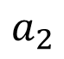
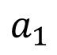
$$a_{1}$$
$$a_{2}$$
+
+
+
+
+
+
+
+
4 times of parameters
x₁
x₂
Input
Notes:
Use a same set of information
Note about the memory

Slide 28
LSTM
c^{t-1}
……
vector
z^{f}
z^{i}
z
zº
4 vectors
x^{t}
Notes:
Identiy
C is vector

Slide 29

LSTM
y^{t}
zº
c^{t-1}
$$×$$
$$＋$$
$$×$$
z^{f}
$$×$$
z^{i}
z^{f}
z^{i}
z
zº
x^{t}
z
Notes:
Identiy
C is vector

Slide 30
LSTM
Extension: “peephole”
y^{t}
y^{t+1}
c^{t-1}
c^{t}
c^{t+1}
$$×$$
$$＋$$
$$×$$
$$×$$
$$＋$$
$$×$$
$$×$$
$$×$$
z^{f}
z^{i}
z
zº
z^{f}
z^{i}
z
zº
c^{t-1}
h^{t-1}
x^{t}
c^{t}
h^{t}
x^{t+1}
Notes:
Identiy
C is vector

Slide 31
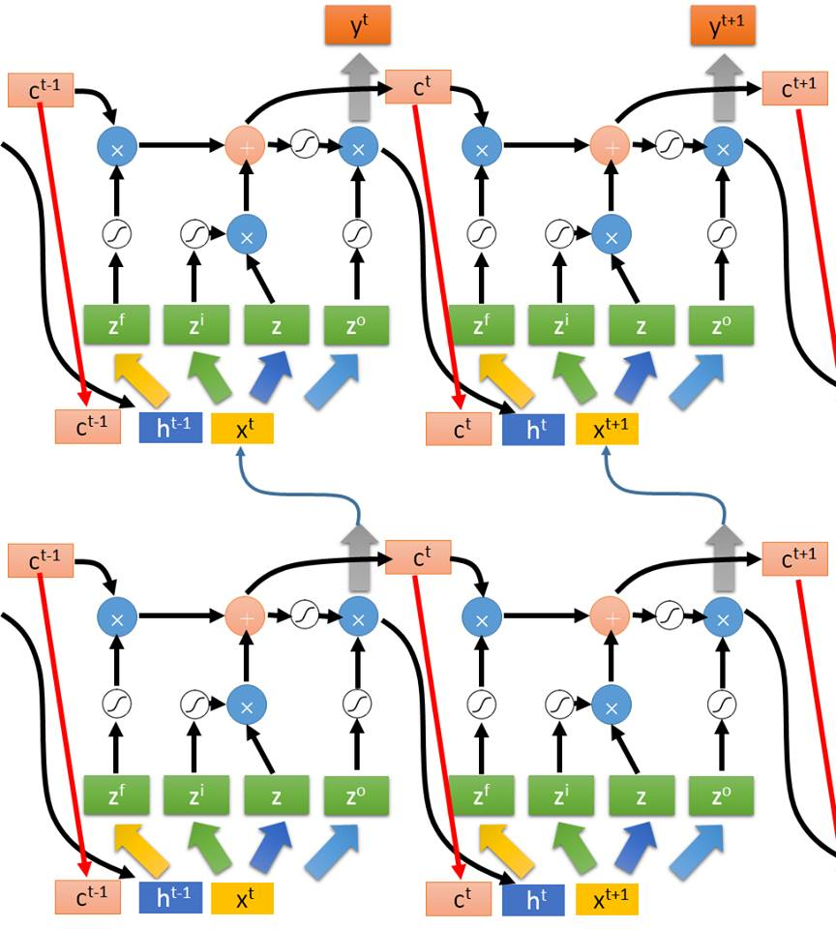
Multiple-layer
LSTM
Don’t worry if you cannot understand this. Keras can handle it.
Keras supports
“LSTM”, “GRU”, “SimpleRNN” layers
This is quite standard now.
https://img.komicolle.org/2015-09-20/src/14426967627131.gif
Notes:
Usually when people say RNN, they mean LSTM!

Slide 32
Learning Target
other
dest
other
0
…
1
…
0
…
…
…
…
0
1
0
0
1
0
y¹
y²
y³
copy
copy
a¹
a²
a³
a¹
a²
W^{i}
x¹
x²
x³
Training
Sentences:
arrive Taipei on November 2nd
other
dest
other
time
time
Notes:
General idea

Slide 33
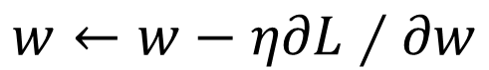

Learning
Backpropagation through time (BPTT)
copy
$$w$$
$$w←w−η∂L∕∂w$$

Slide 34
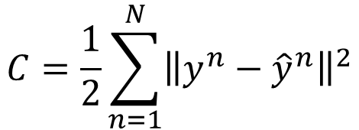
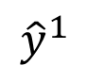
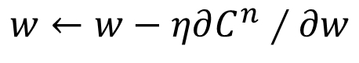
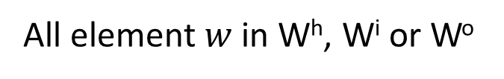
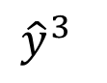
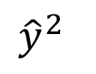
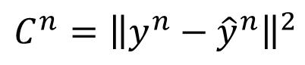
Goal
$${\hat{y}}^{1}$$
$${\hat{y}}^{2}$$
$${\hat{y}}^{3}$$
y¹
y²
y³
Wº
Wº
Wº
init
W^{h}
W^{h}
W^{h}
……
0
W^{i}
W^{i}
W^{i}
x¹
x²
x³
$$C=\frac{1}{2}\sum_{n=1}^{N}{{\left\|y^{n}−{\hat{y}}^{n}\right\|}^{2}}$$
All element $w$ in W^{h}, W^{i} or Wº
$$w←w−η∂C^{n}∕∂w$$
Backpropagation through time (BPTT)
$$C^{n}={\left\|y^{n}−{\hat{y}}^{n}\right\|}^{2}$$
Notes:
Backpropagation through time (BPTT)
RNN Training is very difficult in practice.

Slide 35
Review: Backpropagation
Error signal
Layer
Layer
Forward Pass
Backward Pass
…
…
…
…

Slide 36
Review: Backpropagation
Error signal
Layer L-1
Layer L
……
Backward Pass
……
…
…
……
…
…

Slide 37
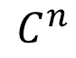
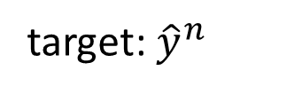
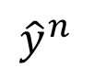
Backpropagation through Time
x^{n}
a^{n}
y^{n}
$${\hat{y}}^{n}$$
UNFOLD:
$$C^{n}$$
A very deep neural network
Input: init, x¹, x², … x^{n}
x^{n-1}
a^{n-1}
output: y^{n}
target: ${\hat{y}}^{n}$
x^{n-2}
a^{n-2}
x¹
a¹
……
……
init

Slide 38
Backpropagation through Time
x^{n}
a^{n}
y^{n}
$${\hat{y}}^{n}$$
UNFOLD:
$$C^{n}$$
A very deep neural network
Input: init, x¹, x², … x^{n}
x^{n-1}
a^{n-1}
output: y^{n}
target: ${\hat{y}}^{n}$
x^{n-2}
a^{n-2}
x¹
a¹
……
……
init
……

Slide 39
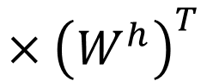
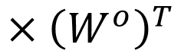
Backpropagation through Time
x^{n}
a^{n}
y^{n}
$${\hat{y}}^{n}$$
UNFOLD:
$$C^{n}$$
A very deep neural network
Input: init, x¹, x², … x^{n}
x^{n-1}
a^{n-1}
output: y^{n}
$${×\left(W^{o}\right)}^{T}$$
target: ${\hat{y}}^{n}$
x^{n-2}
a^{n-2}
$${×\left(W^{h}\right)}^{T}$$
x¹
a¹
……
init

Slide 40
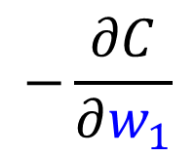
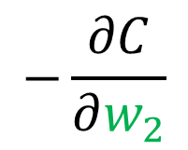
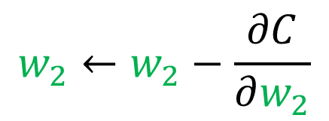
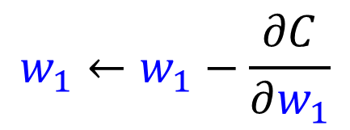
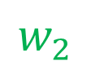
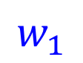
Backpropagation through Time
i
x^{n}
a^{n}
y^{n}
$${\hat{y}}^{n}$$
UNFOLD:
j
$$C^{n}$$
A very deep neural network
i
Input: init, x¹, x², … x^{n}
x^{n-1}
a^{n-1}
output: y^{n}
j
k
$$w_{2}$$
Initialize w₁, w₂
by the same value
target: ${\hat{y}}^{n}$
i
x^{n-2}
a^{n-2}
j
k
$$w_{1}←w_{1}−\frac{∂C}{∂w_{1}}$$
$$−\frac{∂C}{∂w_{2}}$$
$$w_{1}$$
pointer
i
$$w_{2}←w_{2}−\frac{∂C}{∂w_{2}}$$
$$−\frac{∂C}{∂w_{1}}$$
x¹
a¹
……
the same memory
j
pointer
Some weights are shared.
init
k
(The values of w₁, w₂ should always be the same.)

Slide 41
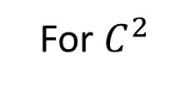
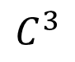
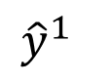
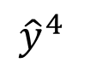
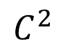
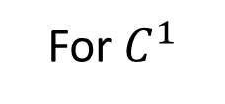
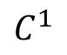
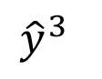




BPTT
Forward
Pass:
Compute a¹, a², a³, a⁴ ……
Backward
Pass:
For $C^{4}$
For $C^{3}$
For $C^{2}$
For $C^{1}$
$${\hat{y}}^{1}$$
$${\hat{y}}^{2}$$
$${\hat{y}}^{3}$$
$${\hat{y}}^{4}$$
$C^{1}$
$C^{2}$
$C^{3}$
$C^{4}$
y¹
y²
y³
y⁴
init
a¹
a²
a³
a⁴
x¹
x²
x³
x⁴
Notes:
If you consider y3, you can not ignore the history
(For multiple utterances
you should init again each time)

Slide 42

Unfortunately ……
RNN-based network is not always easy to learn
Real experiments on Language modeling
sometimes
Total Loss
Lucky
Epoch
Notes:
Not because you have bug haha

Slide 43


The error surface is rough.
The error surface is either very flat or very steep.
Clipping
Cost
Total Loss
w₂
w₁
[Razvan Pascanu, ICML’13]
Notes:
Even adagrad can not handle this problem, maybe RMS prop is better
Source: http://jmlr.org/proceedings/papers/v28/pascanu13.pdf
Large or small is fine. Change quickly is bad

Slide 44










Why?
$$w=1$$
$$y^{1000}=1$$
Large
$${∂L}/{∂w}$$
Small Learning rate?
$$w=1.01$$
$$y^{1000}≈20000$$
$$w=0.99$$
$$y^{1000}≈0$$
small ${∂L}/{∂w}$
Large Learning rate?
$$w=0.01$$
$$y^{1000}≈0$$
=w⁹⁹⁹
y¹
y²
y³
y¹⁰⁰⁰
Toy Example
1
1
1
1
……
w
w
w
1
1
1
1
1
0
0
0
Notes:
Gradient Explode/Gradient Vanishing
Echo state network -> …..

Slide 45

NAG
Methods:
Gradient descent
Valley
Momentum
Nesterov’s Accelerated Gradient (NAG)
Source: http://www.cs.toronto.edu/~fritz/absps/momentum.pdf

Slide 46
NAG
Gradient
Movement
Last Movement
Momentum
Nesterov’s Accelerated Gradient (NAG)
Gradient = 0
Gradient = 0
Notes:
探路、測風向

Slide 47




RMSProp
Smaller Learning Rate
$$w_{2}$$
Larger Learning Rate
Review:
Adagrad
$$w_{1}$$
$$w^{t+1}←w^{t}−\frac{η}{\sqrt{\sum_{i=0}^{t}{{\left(g^{i}\right)}^{2}}}}g^{t}$$
Use first derivative to estimate second derivative
Notes:
Larger Gradient
Smaller Learning
Rate

Slide 48



RMSProp
Error Surface can be even more complex when training RNN.
Smaller Learning Rate
$$w_{2}$$
Larger Learning Rate
$$w_{1}$$

Slide 49









RMSProp
$$w^{1}←w^{0}−\frac{η}{σ^{0}}g^{0}$$
$$σ^{0}=g^{0}$$
$$w^{2}←w^{1}−\frac{η}{σ^{1}}g^{1}$$
$$σ^{1}=\sqrt{{α\left(σ^{0}\right)}^{2}+\left(1−α\right){\left(g^{1}\right)}^{2}}$$
$$w^{3}←w^{2}−\frac{η}{σ^{2}}g^{2}$$
$$σ^{2}=\sqrt{{α\left(σ^{1}\right)}^{2}+\left(1−α\right){\left(g^{2}\right)}^{2}}$$
$$……$$
$$w^{t+1}←w^{t}−\frac{η}{σ^{t}}g^{t}$$
$$σ^{t}=\sqrt{{α\left(σ^{t−1}\right)}^{2}+\left(1−α\right){\left(g^{t}\right)}^{2}}$$
Root Mean Square of the gradients with previous gradients being decayed
Notes:
Root Mean Squares of gradients

Slide 50
Helpful Techniques
Long Short-term Memory (LSTM)
Can deal with gradient vanishing (not gradient explode)
Memory and input are added
The influence never disappears unless forget gate is closed
No Gradient vanishing
add
(If forget gate is opened.)
Gated Recurrent Unit (GRU):
simpler than LSTM
[Cho, EMNLP’14]
Notes:
Reference: http://colah.github.io/posts/2015-08-Understanding-LSTMs/

Slide 51


LSTM can address the gradient vanishing problem.
$$a_{1}$$
$$a_{2}$$
+
+
+
+
+
+
+
+
4 times of parameters
x₁
x₂
Input

Slide 52











LSTM
Extension: “peephole”
y^{t}
y^{t+1}
$$c^{t−1}$$
$$c^{t}$$
$$c^{t+1}$$
$$×$$
$$＋$$
$$×$$
$$×$$
$$＋$$
$$×$$
$$×$$
$$×$$
z^{f}
z^{i}
z
zº
z^{f}
z^{i}
z
zº
h^{t}
x^{t}
h^{t+1}
x^{t+1}
Notes:
C is vector

Slide 53




LSTM
$$δ⨀b$$
δ
a
a
b
$$＋$$
δ
b
$$×$$
δ
δ
$$δ⨀a$$
Constant Error Carrousel (CEC)
y^{t}
y^{t+1}
$$c^{t−1}$$
$$c^{t}$$
$$c^{t+1}$$
$$×$$
$$＋$$
$$×$$
$$×$$
$$＋$$
$$×$$
1
1
$$×$$
$$×$$
z^{f}
z^{i}
z
zº
z^{f}
z^{i}
z
zº
X W^{T}
X W^{T}
h^{t}
x^{t}
h^{t+1}
x^{t+1}
Notes:
C is vector
Math expression

Slide 54


Helpful Techniques
Structurally Constrained Recurrent Network (SCRN)
Clockwise RNN
[Jan Koutnik, JMLR’14]
[Tomas Mikolov, ICLR’15]
Vanilla RNN Initialized with Identity matrix + ReLU activation function [Quoc V. Le, arXiv’15]
Outperform or be comparable with LSTM in 4 different tasks
Notes:
Gated Recurrent Unit (GRU):
http://www.wildml.com/2015/10/recurrent-neural-network-tutorial-part-4-implementing-a-grulstm-rnn-with-python-and-theano/
Structurally Constrained Recurrent Network (SCRN).
Cloclwise RNN

Slide 55

Better Initialization
Quoc V. Le, Navdeep Jaitly, Geoffrey E. Hinton, “A Simple Way to Initialize Recurrent Networks of Rectified Linear Units“, 2015
Vanilla RNN: Initialized with Identity matrix + ReLU

Slide 56
Concluding Remarks
Be careful when training RNN …
Possible solutions:
Clipping the gradients
Advanced optimization technology
NAG
RMSprop
Try LSTM (or other simpler variants)
Better initialization
Notes:
gated recurrent unit (GRU)

Slide 57
More Applications ……
Probability of “arrive” in each slot
Probability of “Taipei” in each slot
Probability of “on” in each slot
y¹
y²
y³
Input and output are both sequences with the same length
store
store
a¹
a²
a³
a¹
a²
RNN can do more than that!
x¹
x²
x³
arrive Taipei on November 2nd

Slide 58
Many to one
Input is a vector sequence, but output is only one vector
Sentiment Analysis
超正面
非常好
看了这部电影太高兴…….
这部电影太糟了…….
这部电影很棒…….
好
不好
Positive (正面)
Negative (负面)
Positive (正面)
不好看
……
我
觉
得
……
太
糟
了

Slide 59
Many to one
[Shen & Lee, Interspeech 16]
Input is a vector sequence, but output is only one vector
O_{T}
Key Term
Extraction
…
Key Terms:
DNN, LSTN
V₁
V₂
V₃
V₄
…
V_{T}
Output Layer
document
Embedding Layer
x₁
x₂
x₃
x₄
…
x_{T}
Hidden Layer
Embedding Layer
V₁
V₂
V₃
V₄
V_{T}
Σα_{i}V_{i}
…
α₁ α₂ α₃ α₄ … α_{T}

Slide 60

Many to Many (Output is shorter)
Both input and output are both sequences, but the output is shorter.
E.g. Speech Recognition
Output:
“好棒”
(character sequence)
Problem?
Trimming
Why can’t it be “好棒棒”
好
好
好
棒
棒
棒
棒
棒
(vector
sequence)
Input:

Slide 61
Many to Many (Output is shorter)
Both input and output are both sequences, but the output is shorter.
Connectionist Temporal Classification (CTC) [Alex Graves, ICML’06][Alex Graves, ICML’14][Haşim Sak, Interspeech’15][Jie Li, Interspeech’15][Andrew Senior, ASRU’15]
“好棒”
Add an extra symbol “φ” representing “null”
“好棒棒”
好
φ
φ
棒
φ
φ
φ
φ
好
φ
φ
棒
φ
棒
φ
φ
Notes:
English is successful, ASRU’15 better than HMM + N-gram

Slide 62
Many to Many (Output is shorter)
CTC: Training
好
φ
棒
φ
φ
φ
Acoustic
Features:
好
φ
φ
棒
φ
φ
Label:
好
棒
All possible alignments are considered as correct.
好
φ
φ
φ
棒
φ
……

Slide 63

Many to Many (Output is shorter)
CTC: example
HIS FRIEND’S
φ
φ
φ
φ
φ
φ
φ
φ
φ
φ
φ
φ
φ
φ
φ
φ
φ
Graves, Alex, and Navdeep Jaitly. "Towards end-to-end speech recognition with recurrent neural networks." Proceedings of the 31st International Conference on Machine Learning (ICML-14). 2014.

Slide 64
Many to Many (No Limitation)
Both input and output are both sequences with different lengths. → Sequence to sequence learning
E.g. Machine Translation (machine learning→机器学习)
Containing all information about input sequence
machine
learning
Notes:
中翻英 英翻中 沒有哪一個一定比較長或比較短

Slide 65
Many to Many (No Limitation)
Both input and output are both sequences with different lengths. → Sequence to sequence learning
E.g. Machine Translation (machine learning→机器学习)
机
器
学
习
惯
性
……
……
machine
learning
Don’t know when to stop
Notes:
中翻英 英翻中 沒有哪一個一定比較長或比較短

Slide 66
Many to Many (No Limitation)
Both input and output are both sequences with different lengths. → Sequence to sequence learning
E.g. Machine Translation (machine learning→机器学习)
机
器
学
习
===
machine
learning
Add a symbol “===“
[Ilya Sutskever, NIPS’14][Dzmitry Bahdanau, arXiv’15]
Notes:
中翻英 英翻中 沒有哪一個一定比較長或比較短
More applications

Slide 67

Beyond Sequence
Syntactic parsing
john
has
a
dog
Oriol Vinyals, Lukasz Kaiser, Terry Koo, Slav Petrov, Ilya Sutskever, Geoffrey Hinton, Grammar as a Foreign Language, NIPS 2015

Slide 68
Sequence-to-sequence Auto-encoder - Text
To understand the meaning of a word sequence, the order of the words can not be ignored.
white blood cells destroying an infection
positive
different
meaning
exactly the same bag-of-word
an infection destroying white blood cells
negative
Notes:
傳染病 infection

Slide 69

Sequence-to-sequence Auto-encoder - Text
Li, Jiwei, Minh-Thang Luong, and Dan Jurafsky. "A hierarchical neural autoencoder for paragraphs and documents." arXiv preprint arXiv:1506.01057(2015).

Slide 70

Sequence-to-sequence Auto-encoder - Text
Li, Jiwei, Minh-Thang Luong, and Dan Jurafsky. "A hierarchical neural autoencoder for paragraphs and documents." arXiv preprint arXiv:1506.01057(2015).

Slide 71






Sequence-to-sequence Auto-encoder - Speech
Dimension reduction for a sequence with variable length
audio segments (word-level)
Fixed-length vector
dog
never
dog
never
Yu-An Chung, Chao-Chung Wu, Chia-Hao Shen,
Hung-Yi Lee, Lin-Shan Lee, Audio Word2Vec: Unsupervised Learning of Audio Segment Representations using Sequence-to-sequence Autoencoder, Interspeech 2016
dogs
never
ever
ever
Notes:
With coloer

Slide 72




Sequence-to-sequence Auto-encoder - Speech
Audio archive divided into variable-length audio segments
Off-line
Audio Segment to Vector
Audio Segment to Vector
Similarity
Spoken Query
On-line
Search Result

Slide 73

Sequence-to-sequence Auto-encoder - Speech
vector
audio segment
RNN Encoder
The values in the memory represent the whole audio segment
The vector we want
How to train RNN Encoder?
x₁
x₂
x₃
x₄
acoustic features
audio segment

Slide 74
Sequence-to-sequence Auto-encoder
Input acoustic features
x₁
x₂
x₃
x₄
The RNN encoder and decoder are jointly trained.
y₁
y₂
y₃
y₄
RNN Encoder
RNN Decoder
x₁
x₂
x₃
x₄
acoustic features
audio segment

Slide 75


Sequence-to-sequence Auto-encoder - Speech
Visualizing embedding vectors of the words
fear
fame
name
near

Slide 76

Chat-bot
Notes:
Will you build a wall?

Slide 77

Attention-based Model
What you learned in these lectures
Breakfast today
What is deep learning?
summer vacation 10 years ago
Organize
Answer
http://henrylo1605.blogspot.tw/2015/05/blog-post_56.html

Slide 78
Attention-based Model
Input
DNN/RNN
output
Reading Head Controller
Reading Head
……
……
Machine’s Memory
Ref: http://speech.ee.ntu.edu.tw/~tlkagk/courses/MLDS_2015_2/Lecture/Attain%20(v3).ecm.mp4/index.html
Notes:
Need an example …… ok, in the future

Slide 79
Attention-based Model v2
Input
DNN/RNN
output
Reading Head Controller
Writing Head Controller
Writing Head
Reading Head
……
……
Machine’s Memory
Neural Turing Machine
Notes:
Need an example …… ok, in the future

Slide 80

Reading Comprehension
Query
DNN/RNN
answer
Reading Head Controller
Semantic Analysis
……
……
Each sentence becomes a vector.

Slide 81

Reading Comprehension
End-To-End Memory Networks. S. Sukhbaatar, A. Szlam, J. Weston, R. Fergus. NIPS, 2015.
The position of reading head:
Keras has example: https://github.com/fchollet/keras/blob/master/examples/babi_memnn.py

Slide 82

Visual Question Answering
source: http://visualqa.org/
Notes:
太陽花梗

Slide 83

Visual Question Answering
Query
DNN/RNN
answer
Reading Head Controller
CNN
A vector for each region

Slide 84

Speech Question Answering
TOEFL Listening Comprehension Test by Machine
Example:
(The original story is 5 min long.)
Audio Story:
Question: “ What is a possible origin of Venus’ clouds? ”
Choices:
(A) gases released as a result of volcanic activity
(B) chemical reactions caused by high surface temperatures
(C) bursts of radio energy from the plane's surface
(D) strong winds that blow dust into the atmosphere

Slide 85

Model Architecture
Everything is learned from training examples
Answer
…… It be quite possible that this be due to volcanic eruption because volcanic eruption often emit gas. If that be the case volcanism could very well be the root cause of Venus 's thick cloud cover. And also we have observe burst of radio energy from the planet 's surface. These burst be similar to what we see when volcano erupt on earth ……
Select the choice most similar to the answer
Attention
Attention
Question Semantics
Semantic Analysis
Speech Recognition
Semantic Analysis
Question:
Audio Story:
“what is a possible origin of Venus‘ clouds?"
Notes:
Mamery network proposed by FB’s AI team

Slide 86

Simple Baselines
Experimental setup:
717 for training,
124 for validation, 122 for testing
(2) select the shortest choice as answer
(4) the choice with semantic most similar to others
Accuracy (%)
random
(1)
(2)
(3)
(4)
(5)
(6)
(7)
Naive Approaches

Slide 87
Memory Network
Memory Network: 39.2%
(proposed by FB AI group)
Accuracy (%)
(1)
(2)
(3)
(4)
(5)
(6)
(7)
Naive Approaches

Slide 88
Proposed Approach
[Tseng & Lee, Interspeech 16]
[Fang & Hsu & Lee, SLT 16]
Proposed Approach: 48.8%
Memory Network: 39.2%
(proposed by FB AI group)
Accuracy (%)
(1)
(2)
(3)
(4)
(5)
(6)
(7)
Naive Approaches

Slide 89
To Learn More ……
The Unreasonable Effectiveness of Recurrent Neural Networks
http://karpathy.github.io/2015/05/21/rnn-effectiveness/
Understanding LSTM Networks
http://colah.github.io/posts/2015-08-Understanding-LSTMs/

Slide 90
Deep & Structured

Slide 91


RNN v.s. Structured Learning
RNN, LSTM
Unidirectional RNN does not consider the whole sequence
Cost and error not always related
Deep
HMM, CRF, Structured Perceptron/SVM
Using Viterbi, so consider the whole sequence
How about Bidirectional RNN?
Can explicitly consider the label dependency
Cost is the upper bound of error
?

Slide 92

Integrated Together
HMM, CRF, Structured Perceptron/SVM
Explicitly model the dependency
Deep
Cost is the upper bound of error
RNN, LSTM
http://photo30.bababian.com/upload1/20100415/42E9331A6580A46A5F89E98638B8FD76.jpg

Slide 93



Integrated together
Speech Recognition: CNN/LSTM/DNN + HMM
$$P\left(x,y\right)=P\left( y_{1}|start\right)\prod_{l=1}^{L−1}{P\left(y_{l+1}|y_{l}\right)}P\left(end|y_{L}\right)\prod_{l=1}^{L}{P\left(x_{l}|y_{l}\right)}$$
P(a|x_{l})
P(b|x_{l})
P(c|x_{l})
……
$$P\left(x_{l}|y_{l}\right)=\frac{P\left(x_{l},y_{l}\right)}{P\left(y_{l}\right)}$$
……
RNN
……
……
RNN
$$=\frac{P\left(y_{l}|x_{l}\right)P\left(x_{l}\right)}{P\left(y_{l}\right)}$$
……
x_{l}
……
Count

Slide 94


Integrated together
Semantic Tagging: Bi-directional LSTM + CRF/Structured SVM
……
……
$$w∙φ\left(x,y\right)$$
……
……
RNN
……
……
Testing:
RNN
$$\tilde{y}=arg\max_{y∈𝕐}{\text{w}\text{∙}φ\text{(}\text{x}\text{,}\text{y}\text{)}}$$
……
……
Notes:
Training
Mesnil, G., Dauphin, Y., Kaisheng Yao, Bengio, Y., Li Deng, Hakkani-Tur, D., Xiaodong He, Heck, L., Tur, G., Dong Yu, Zweig, G., "Using Recurrent Neural Networks for Slot Filling in Spoken Language Understanding," in Audio, Speech, and Language Processing, IEEE/ACM Transactions on , vol.23, no.3, pp.530-539, March 2015

Slide 95
Is structured learning practical?
Problem 3: you know how to learn F(x)
Considering GAN
Real x
Noise
From
Gaussian
Generator
Discri-minator
x
1/0
Generated
Inference:
Evaluation Function
F(x)
Problem 2
Problem 1

Slide 96
Is structured learning practical?
Real
(x,y) pair
Conditional GAN
Generator
Discri-minator
x
y
1/0
x

Slide 97
Sounds crazy? People do think in this way …
Deep and Structured will be the future.
Connect Energy-based model with GAN:
A Connection Between Generative Adversarial Networks, Inverse Reinforcement Learning, and Energy-Based Models
Deep Directed Generative Models with Energy-Based Probability Estimation
ENERGY-BASED GENERATIVE ADVERSARIAL NETWORKS
Deep learning model for inference
Deep Unfolding: Model-Based Inspiration of Novel Deep Architectures
Conditional Random Fields as Recurrent Neural Networks

